Slide 1
GUVI Knowledge Retrieval Chatbot using RAG
Hida Fathima P H

Slide 2
Introduction
The project lies in the domain of Artificial Intelligence and Educational Technology (EdTech).
It focuses on improving student learning experiences using AI-driven conversational systems.
With the rise of online learning, intelligent chatbots enhance accessibility and personalized learning.

Slide 3
Problem Statement
Build an intelligent RAG-based chatbot for the GUVI EdTech platform that assists learners with instant, accurate responses to their queries based on GUVI’s course materials, blogs, FAQs, and documentation.
The Challenge: Standard LLMs (like ChatGPT) don't know GUVI's specific, private data and will "hallucinate" or make up answers.

Slide 4
Business Use Cases
Personalized Course Assistant: Provides summarized, context-based answers from GUVI’s own data, 24/7.
Instant Technical Query Solver: Acts as a "first line of defense" for common technical questions, reducing mentor workload and forum noise.
Career & Skill Path Guidance: Can retrieve and explain GUVI's course paths and program details based on user goals.
Instructor Support: Automatically answers common, repetitive student questions.

Slide 5
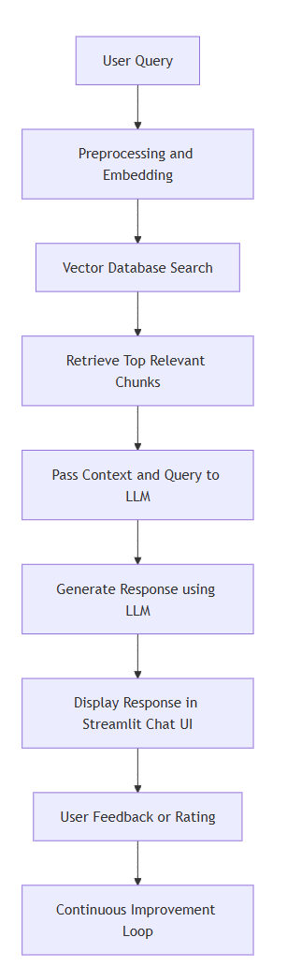
The Solution: RAG Workflow
Our system works like an "open-book exam" for the AI, ensuring it only uses facts.

Slide 6
The Technology Stack
UI Frontend: Streamlit
Orchestrator: LangChain
Embedding Model (Retrieval): Hugging Face (all-MiniLM-L6-v2)
Vector Database: FAISS (local)
Generation LLM: Cohere API (command-a-03-2025)
Configuration: python-dotenv (for API key management)

Slide 7
Phase 1 - Building the Knowledge Base (ingest.py)
1. Load: Reads the guvi_data.txt file using TextLoader.
2. Chunk: Splits the large document into 258 smaller chunks (1000 characters each) using RecursiveCharacterTextSplitter. This keeps related sentences together.
3. Embed: Converts each text chunk into a 384-dimension vector (a list of numbers) using the Hugging Face all-MiniLM-L6-v2 model. This vector represents the meaning of the text.
4. Store: Saves all 258 vectors into a high-speed, local FAISS database.

Slide 8
Phase 2 - The Live Chatbot (app.py)
This is the RAG pipeline in action.
1. Load: @st.cache_resource loads the FAISS DB and connects to Cohere once for high performance.
2. Retrieve: When a user asks a question, the app embeds the question and uses FAISS to find the Top-5 most relevant text chunks from the database.
3. Augment: LangChain's RetrievalQA chain "stuffs" these 5 chunks into our SYSTEM_PROMPT.
4. Generate: The complete prompt (Context + Question) is sent to the Cohere LLM, which generates the final, detailed answer.

Slide 9
The "Brain" - Our System Prompt (config.py)
The SYSTEM_PROMPT in config.py is how we control the AI. This is how we force the LLM to be factual.
Key Instructions:
"...based *only* on the provided context."
"...Write a comprehensive, multi-sentence answer (at least 4-8 sentences)."
"If the context does not contain the answer, you MUST say: 'I'm sorry...'"
This prompt is what prevents the AI from hallucinating and ensures all answers are detailed and relevant.

Slide 10
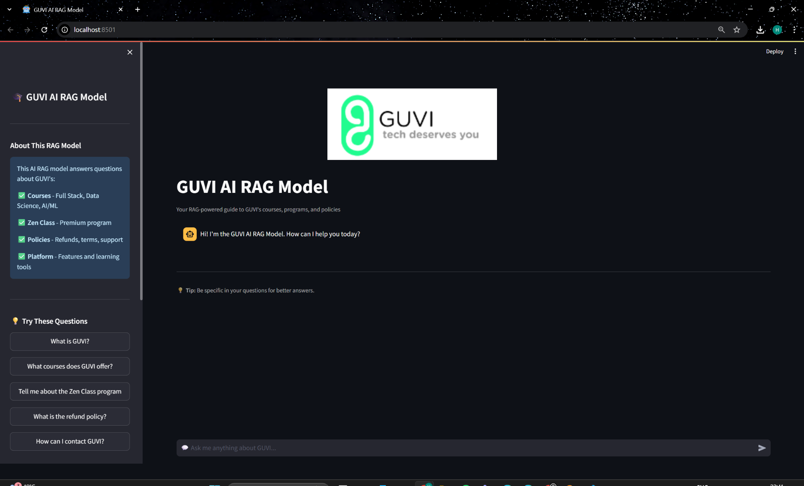
LIVE DEMO

Slide 11
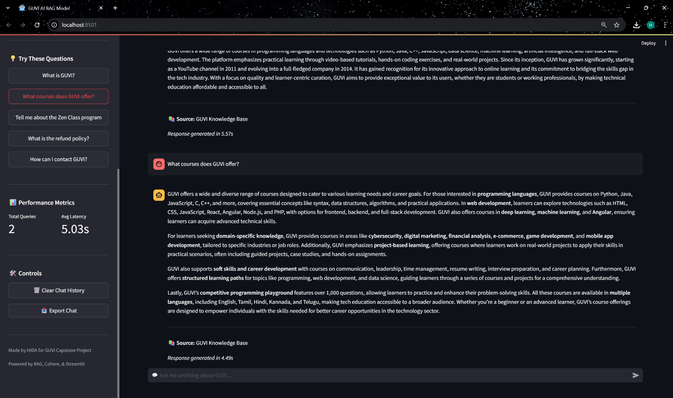

Slide 12
Project Evaluation
1. Quantitative (The Numbers):
Response Latency: Tracked in real-time. The app is fast, with an average latency of ~2-4 seconds per answer (as shown in the sidebar).
2. Qualitative (The Quality):
Contextual Accuracy (The "Guardrail"): The bot correctly refuses to answer off-topic questions (like the "France" demo).
Response Relevance: The bot provides correct answers to in-context questions (like the "Zen Class" demo).

Slide 13
Conclusion & Future Work
The RAG chatbot successfully provides accurate, detailed, and non-hallucinatory answers. It demonstrates a scalable and effective solution for enhancing student support at GUVI.
Future Work:
  Deploy: Upload the app to Streamlit Cloud for 24/7 global access.
  Expand Data: Add a document uploader to ingest.py to process PDFs, DOCX, and website URLs.
  Add Memory: Implement a true conversational memory so the bot can remember the last few questions.

Slide 14
Thank You!!!

